Slide 1
HR
File created on: 10/19/2024 8:27:21 PM

Slide 2
Part 1: Training, Satisfaction, and Performance
This part focuses on the relationships between training, employee satisfaction, and performance, diving deep into how different demographics respond to training opportunities.

Slide 3
Training's Impact on Performance

Slide 4
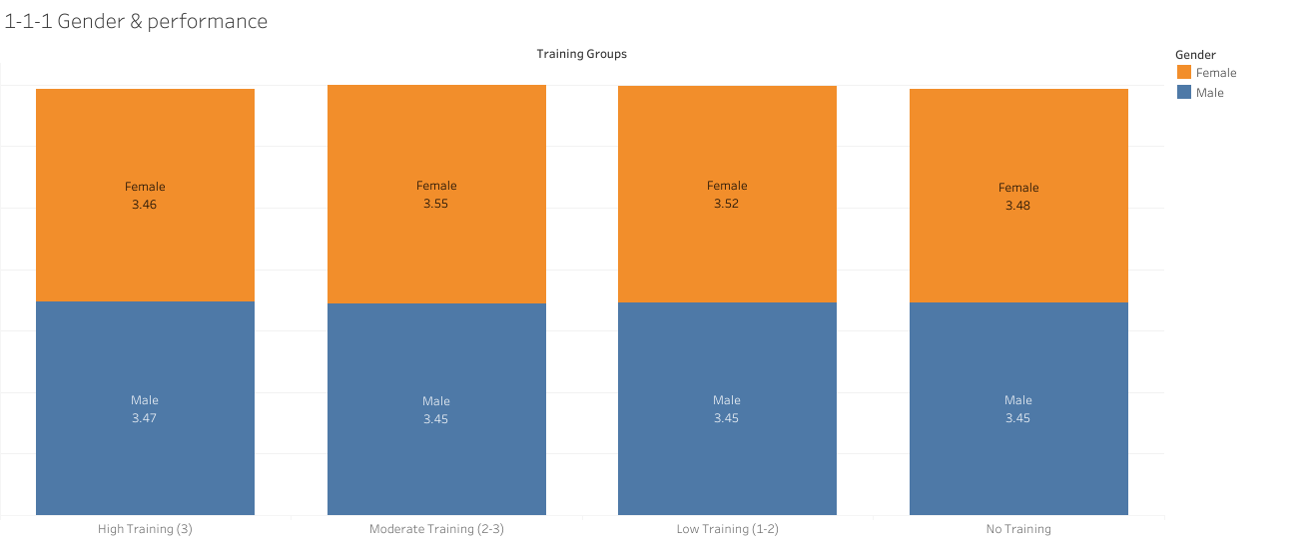
Gender & Performance

Slide 5
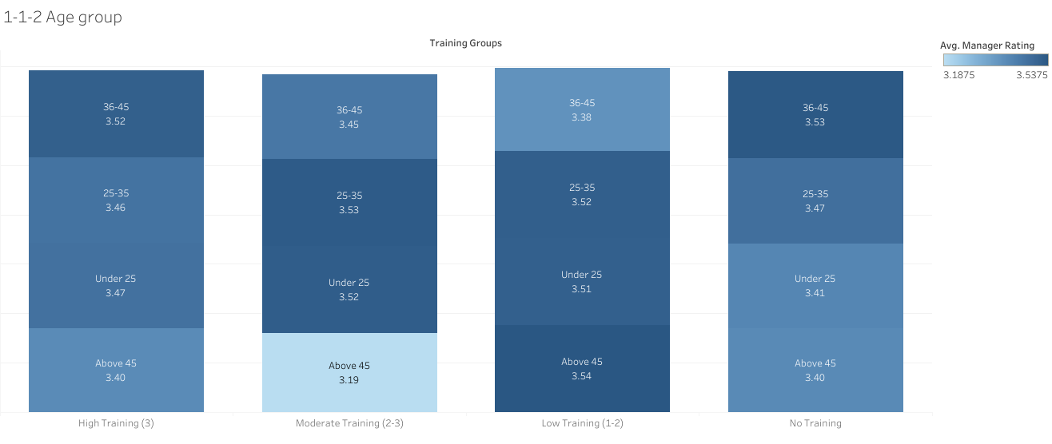
Write here

Slide 6
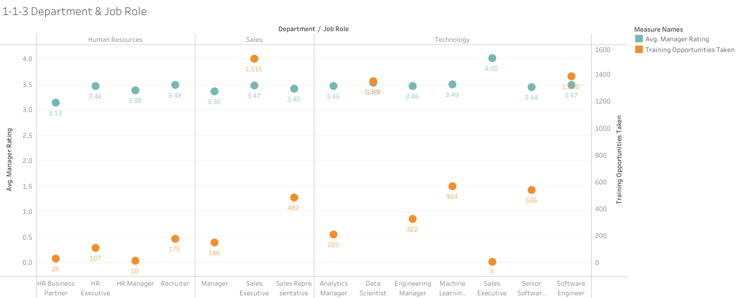
Write here

Slide 7
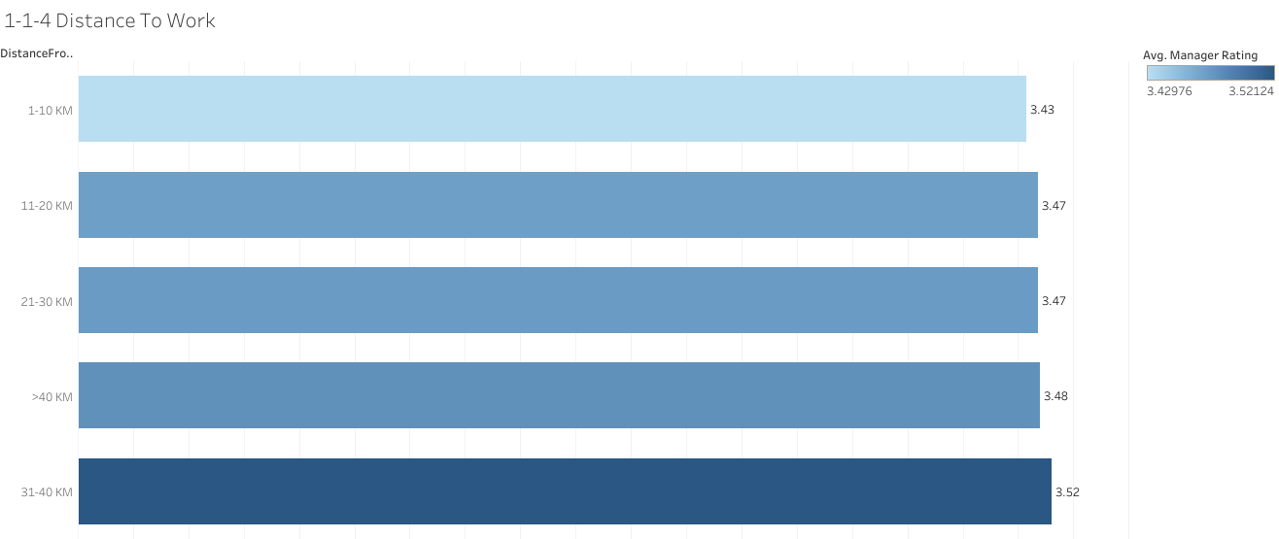
Write here

Slide 8
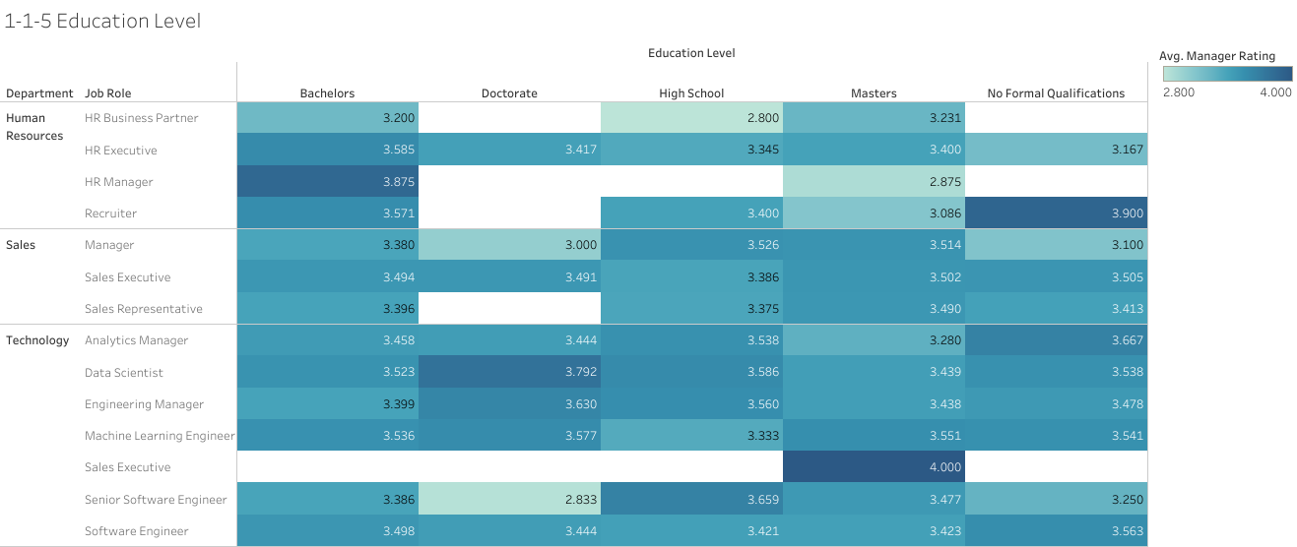
Write here

Slide 9
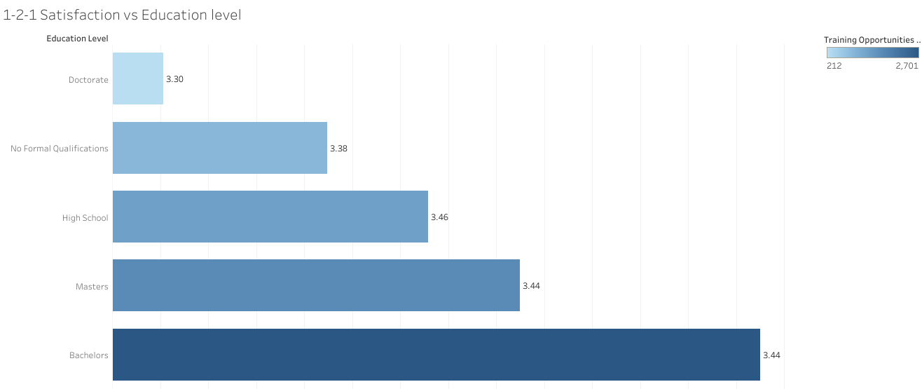
Write here

Slide 10
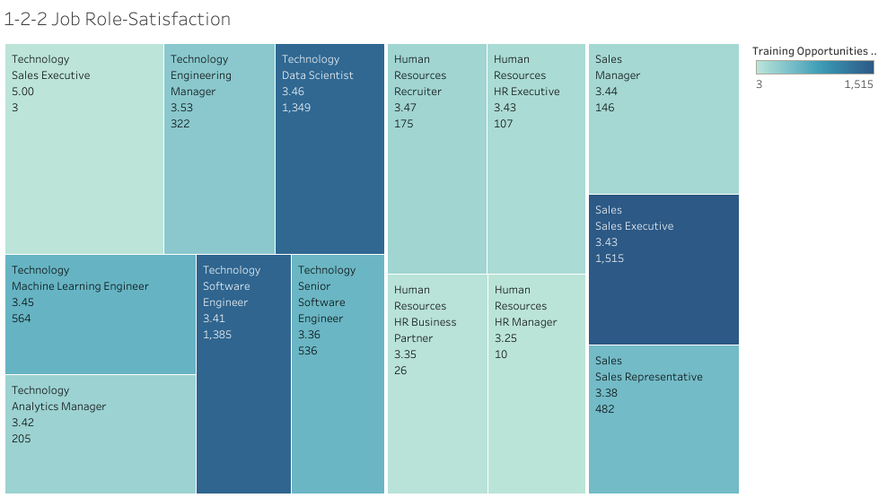
Write here

Slide 11
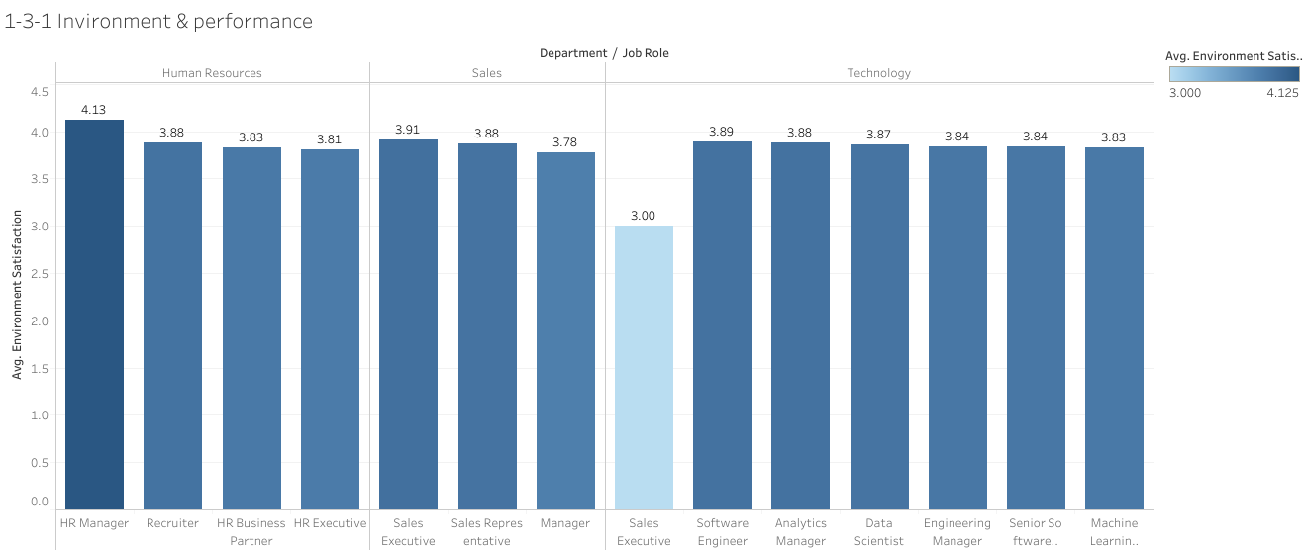
Write here

Slide 12
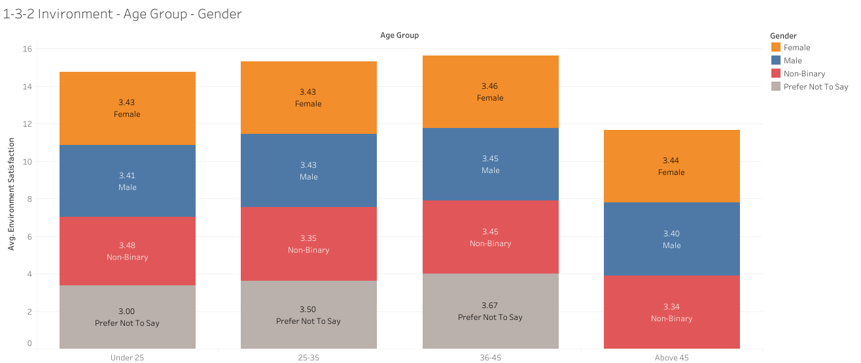
Write here

Slide 13
Job Satisfaction and Training Opportunities

Slide 14
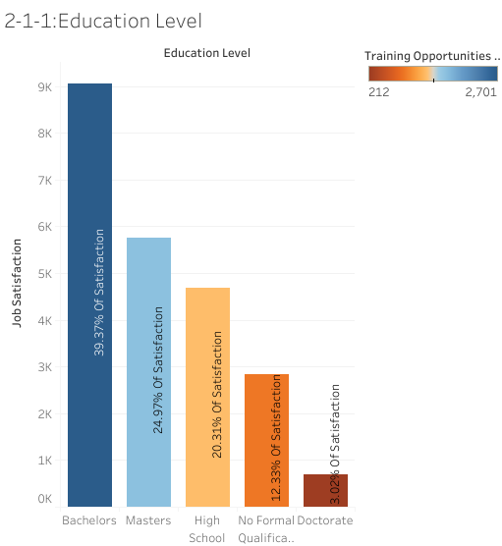
Are more highly educated employees more satisfied with training opportunities, and how does this reflect in their performance?

Slide 15
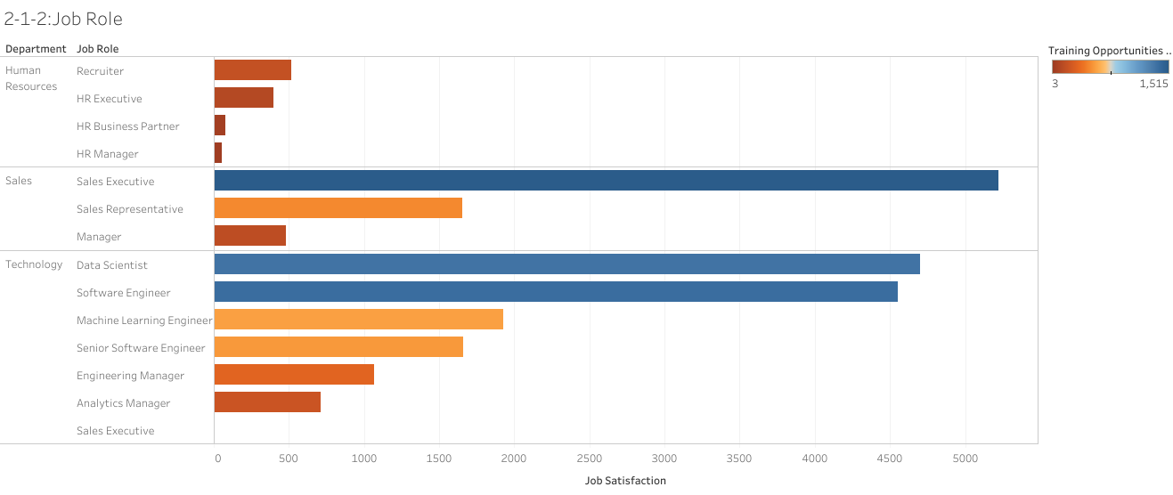
Which job roles or departments are linked to higher satisfaction post-training?

Slide 16
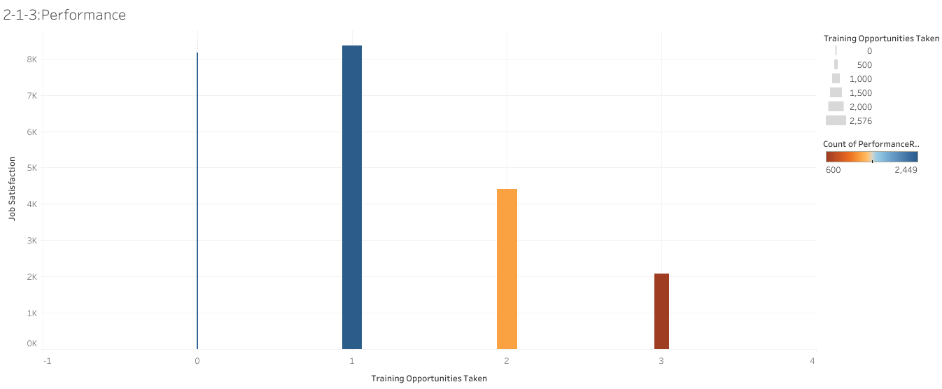
How do employees who undergo more training programs compare in terms of both Job Satisfaction and Performance?

Slide 17
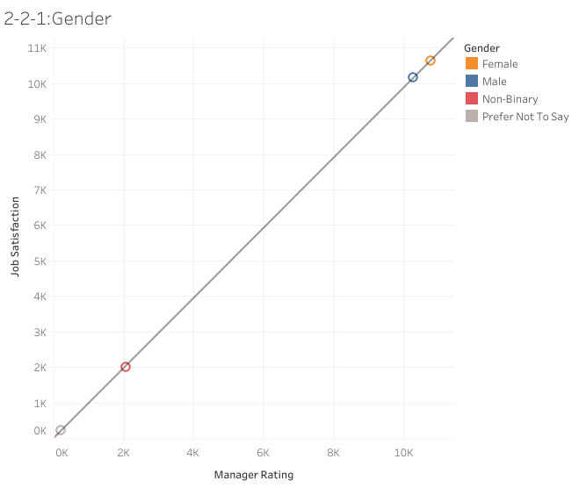
Do employees across different gender identities show stronger correlations between satisfaction and performance?

Slide 18
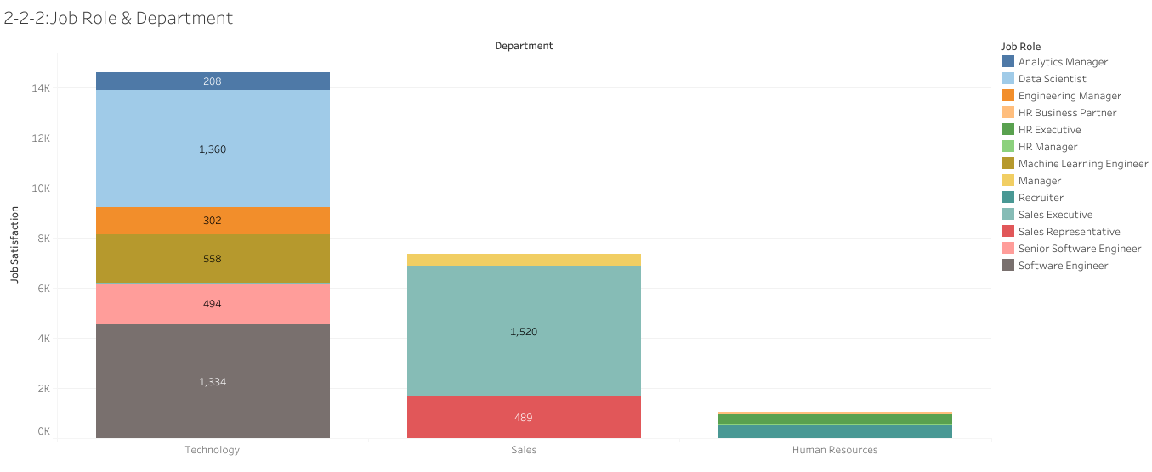
Are some departments better at maintaining both high satisfaction and high performance?

Slide 19
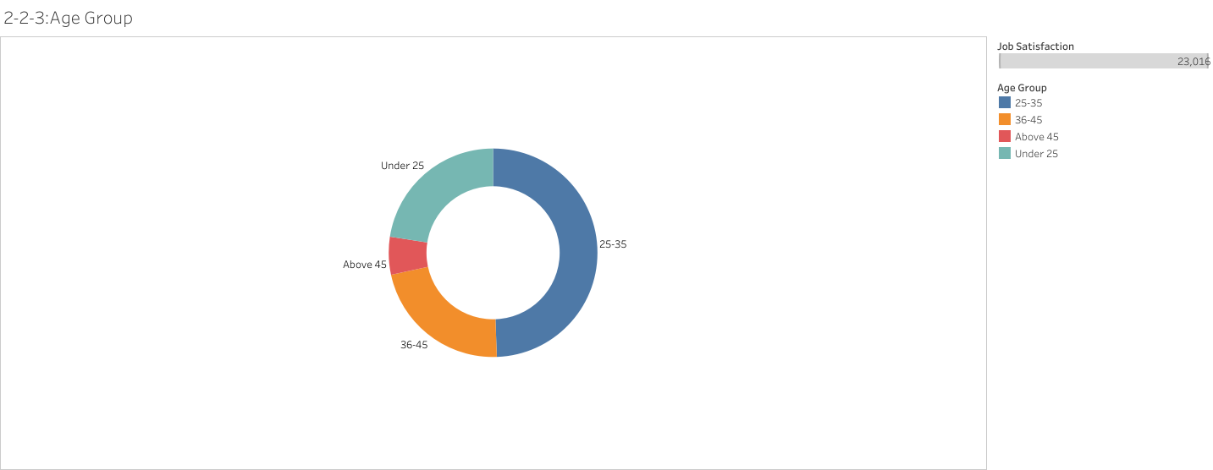
Does the relationship between satisfaction and performance vary by age group?

Slide 20
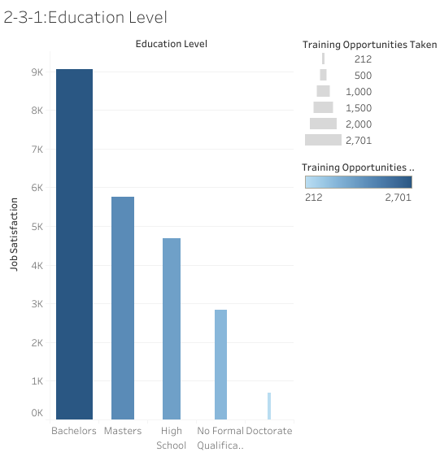
Are more highly educated employees more satisfied with training opportunities?

Slide 21
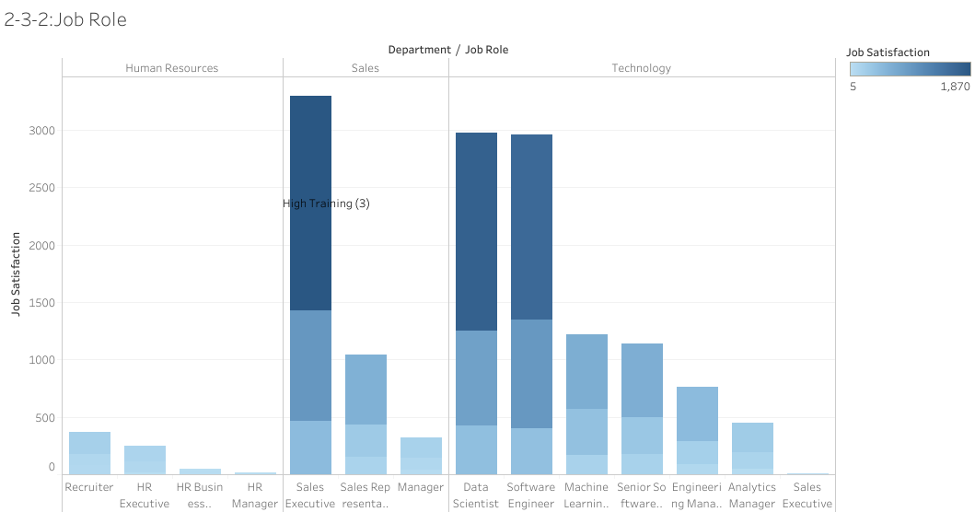
Which job roles or departments are linked to higher satisfaction post-training?

Slide 22
Part 2: Overtime, Work-Life Balance, and Attrition
This section explores how overtime and work-life balance affect employee performance, satisfaction, and retention, with a focus on demographic variations.

Slide 23
Work-Life Balance and Performance

Slide 24
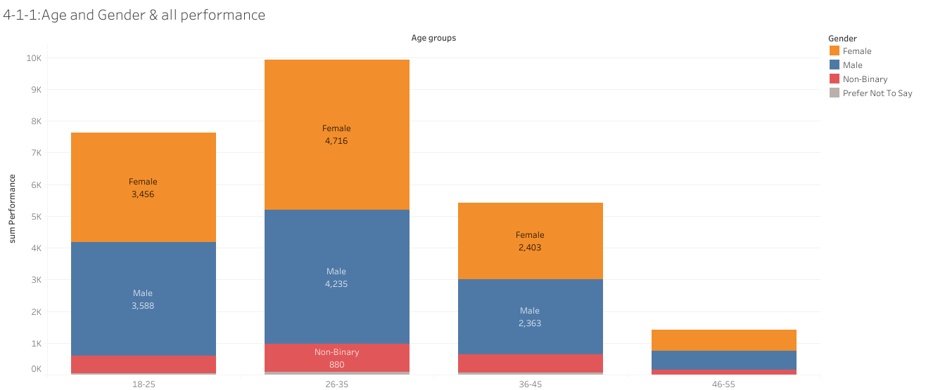
Overall Performance Ratings The older the employee,
the lower the employee's performance.

Slide 25

Total Work-Life Balance Ratings The older the employee,
the lower the employee's work-life balance.

Slide 26
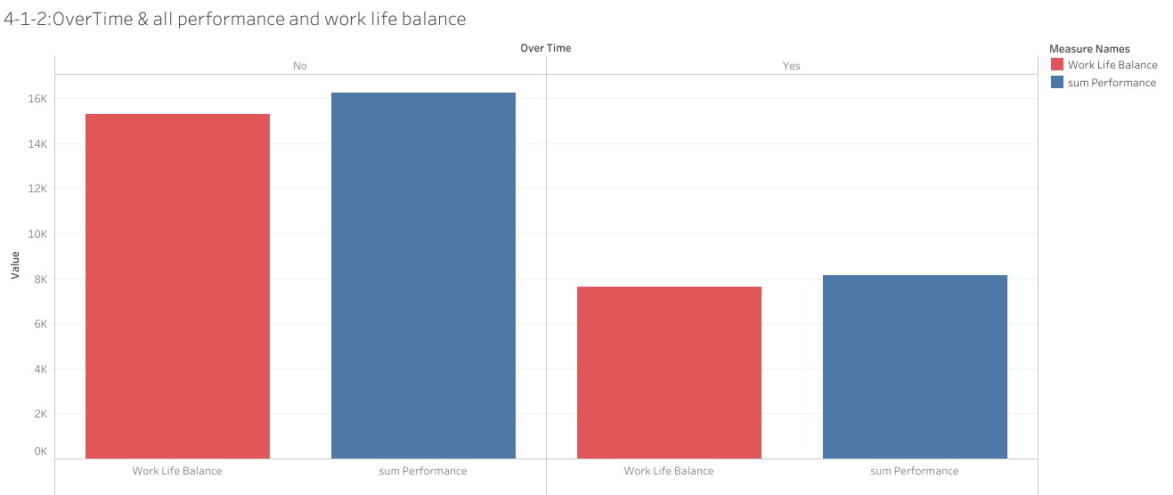
Employees who do not work overtime have better performance and greater balance in their lives, at a low rate.

Slide 27

Performance Ratings ( Self Rating , Manager Rating ) The older the employee, the lower the employee's performance.

Slide 28
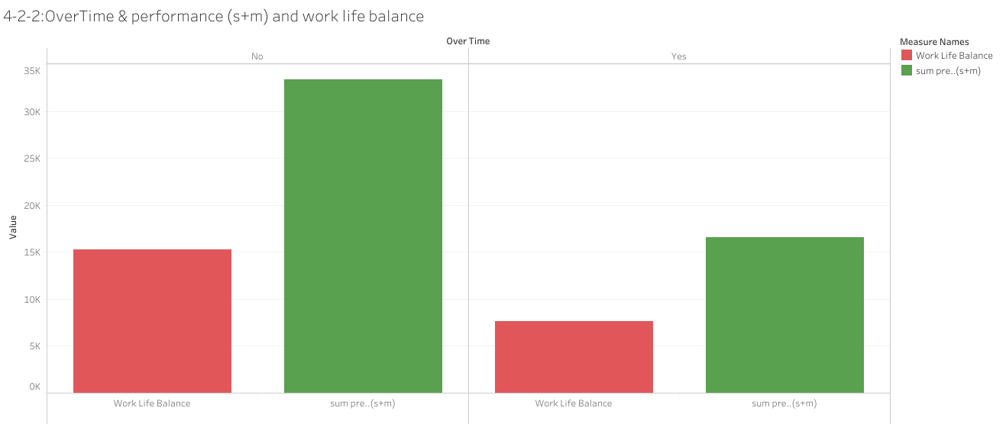
Employees who do not work overtime have better performance and greater balance in their lives, at a low rate.

Slide 29
Work-Life Balance and Attrition

Slide 30
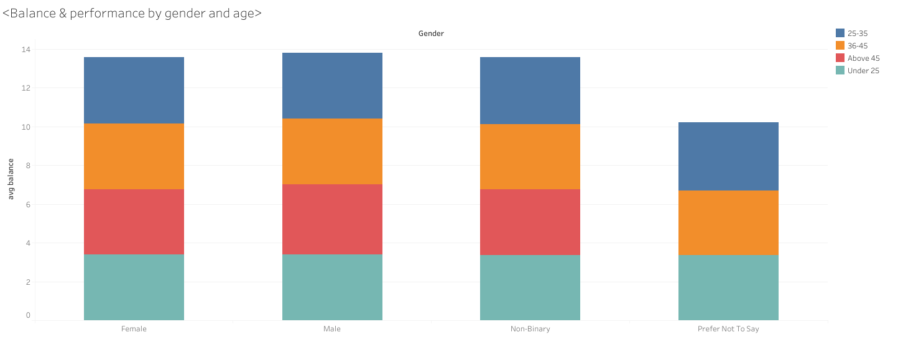
Balance&performance by gender and age .

Slide 31
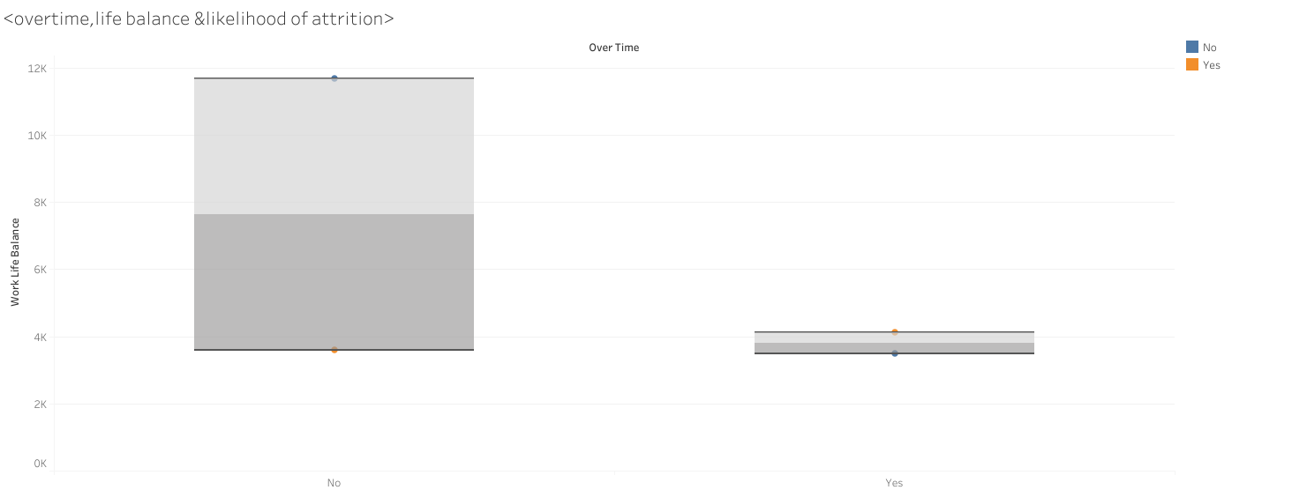
Employees who work overtime have lower work-life balance.

Slide 32
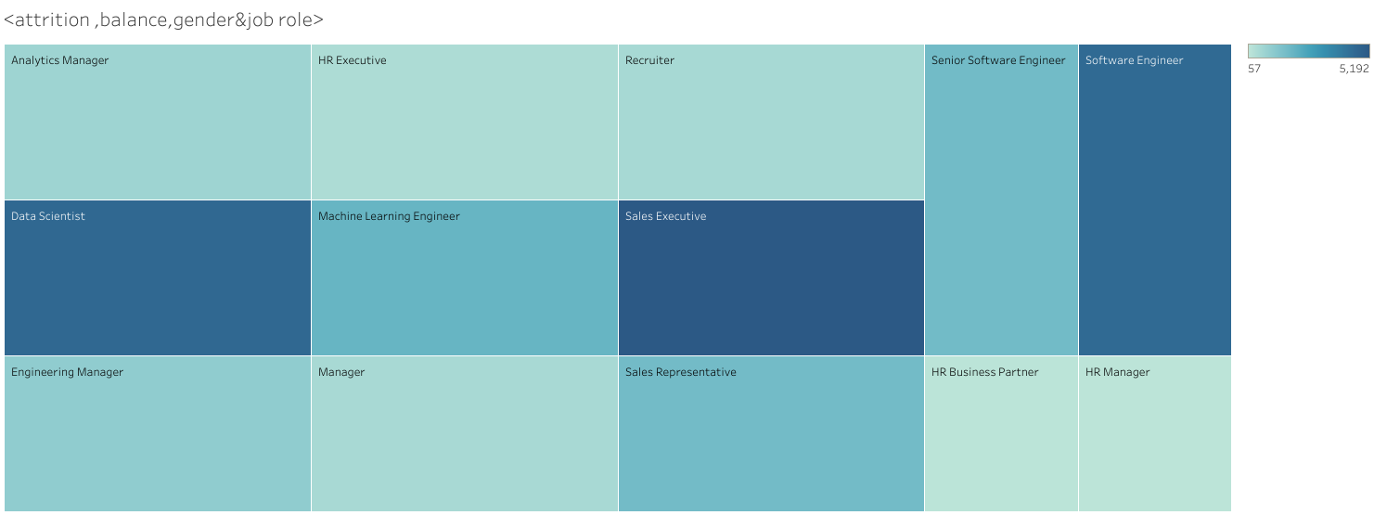
sales excutive,software engineers &data scientists are of greater work-life balance.

Slide 33
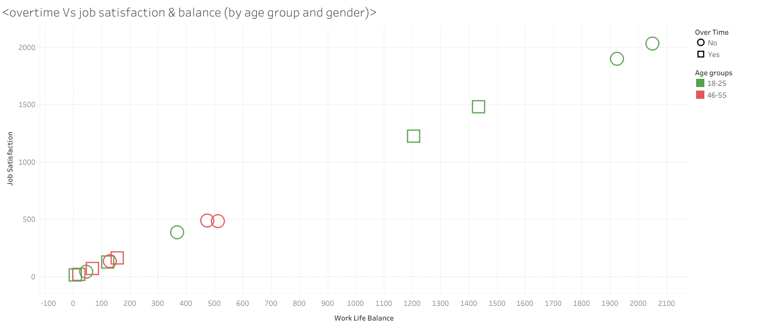
Older age groups show least job satisfaction

Slide 34
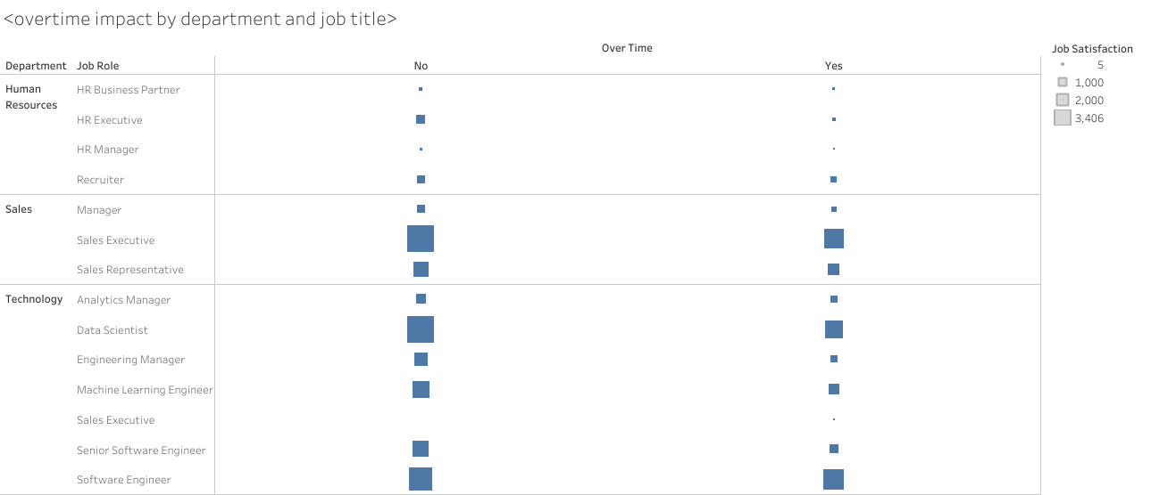
Overtime lower job satisfaction in all departments

Slide 35
Part 3: Manager Roles, Retention, and Loyalty
This part examines how demographic factors influence managerial roles and dives into the long-term metrics of retention and loyalty, including attrition rates, tenure, and promotions.

Slide 36
Manager Role and Retention Analysis

Slide 37
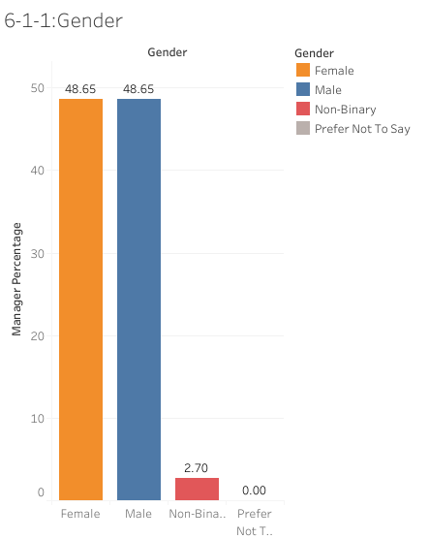
The percentage of male and female employees in managerial roles are in balances in leadership positions

Slide 38
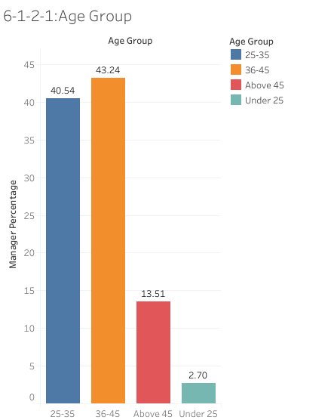
Different age groups compare in terms of percentage in managerial positions showing that employees with age range between 25 and 46 more likely to be in leadership roles

Slide 39
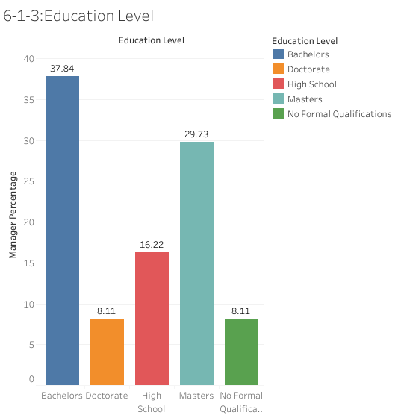
The percentage of employees with different education levels in managerial roles showing that employees with Bachelors and Masters are more likely to be in leadership roles

Slide 40
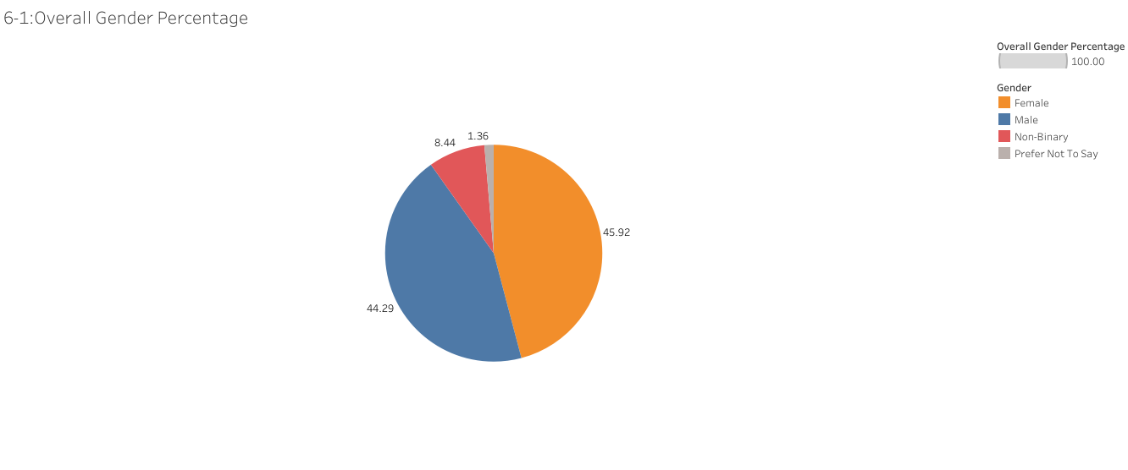
The percentage of employees according to Gender

Slide 41
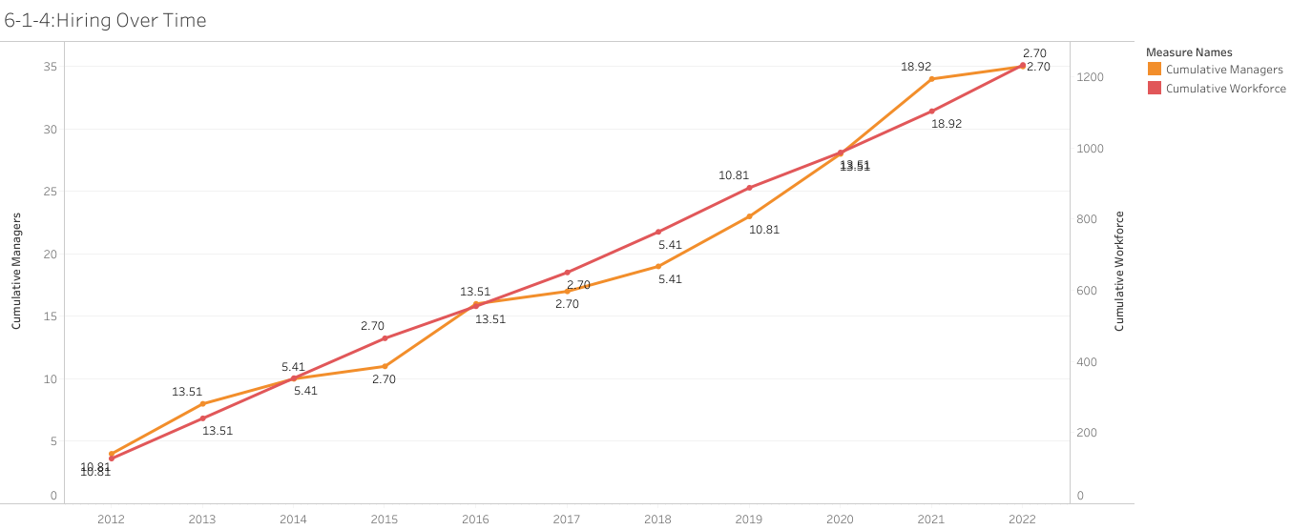
The trends in hiring over time, and how do the correlate with workforce development and managerial growth

Slide 42
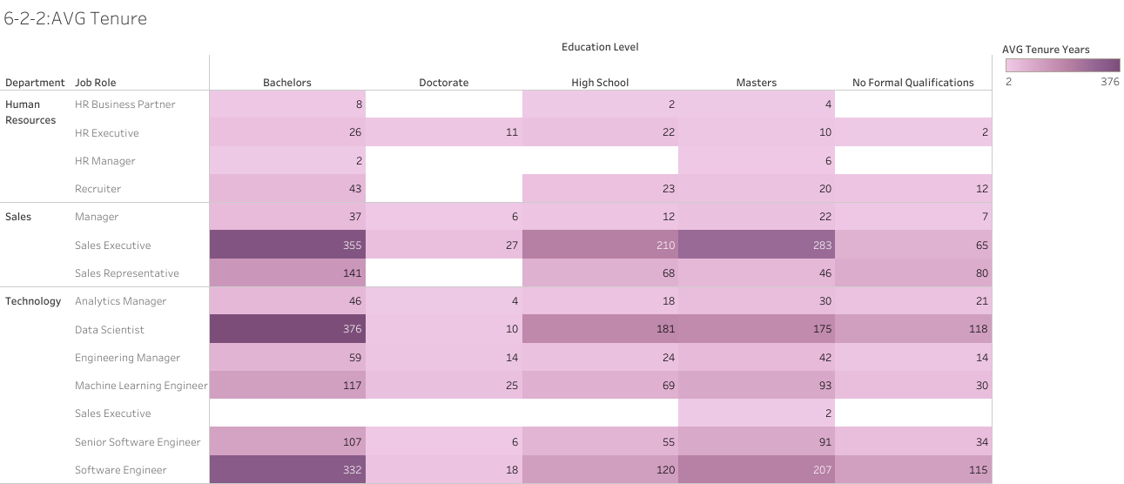
How long employees stay with the company, according to Department, Job Role, and Education Level

Slide 43
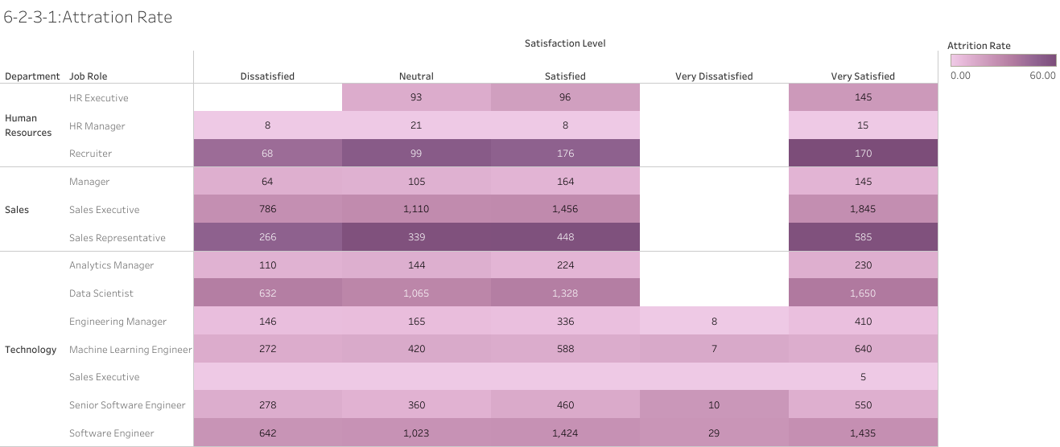
Calculate attrition rates by Department, Role, and Job Satisfaction. Showing employees with higher satisfaction less likely to leave

Slide 44
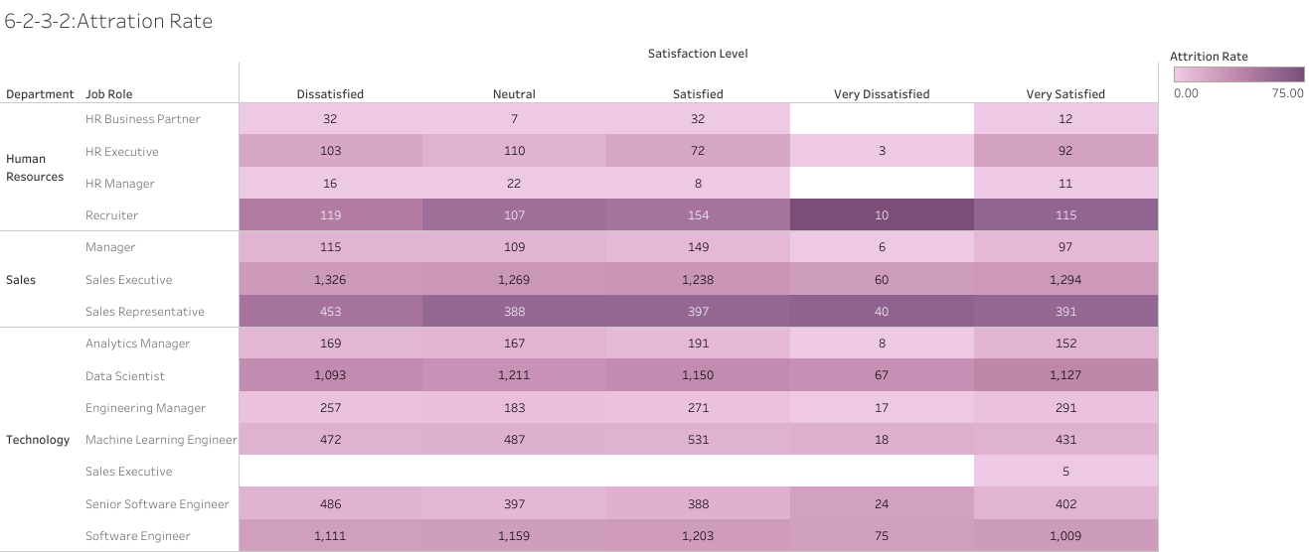
Calculate attrition rates by Department, Role, and work-life balance. Showing employees with higher satisfaction less likely to leave

Slide 45
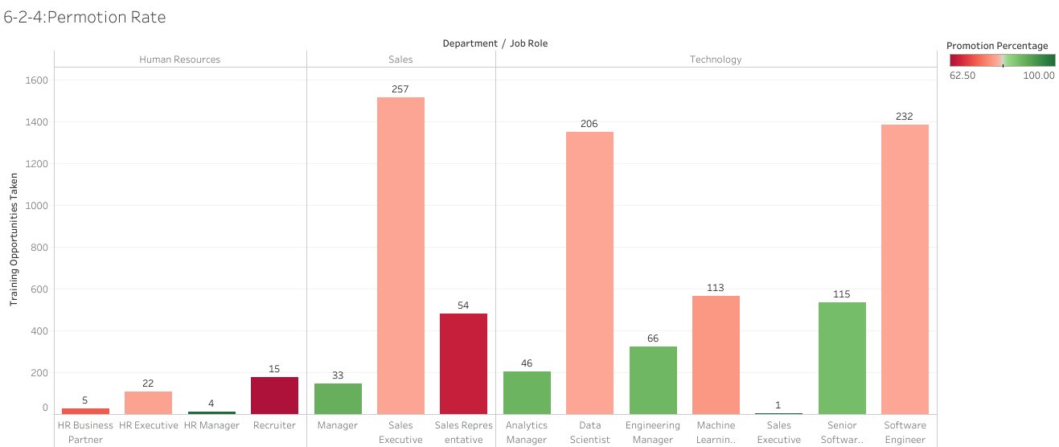
Track promotion rates by Department and Job Role, showing whether training opportunities correlate with faster promotions.

Slide 46
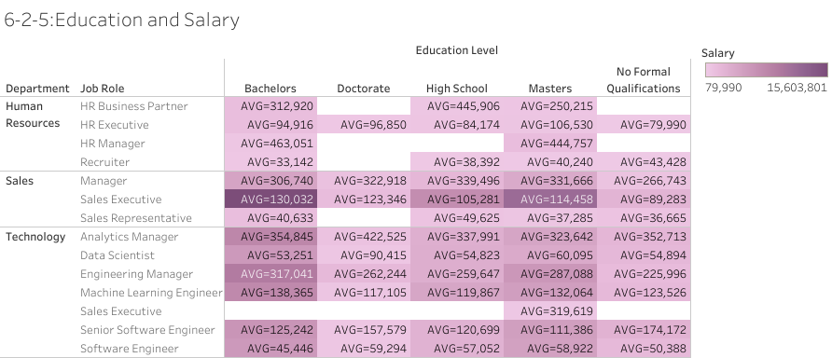
Employees with higher education levels receive higher salaries, showing how does this compare across Job Role & Department

Slide 47
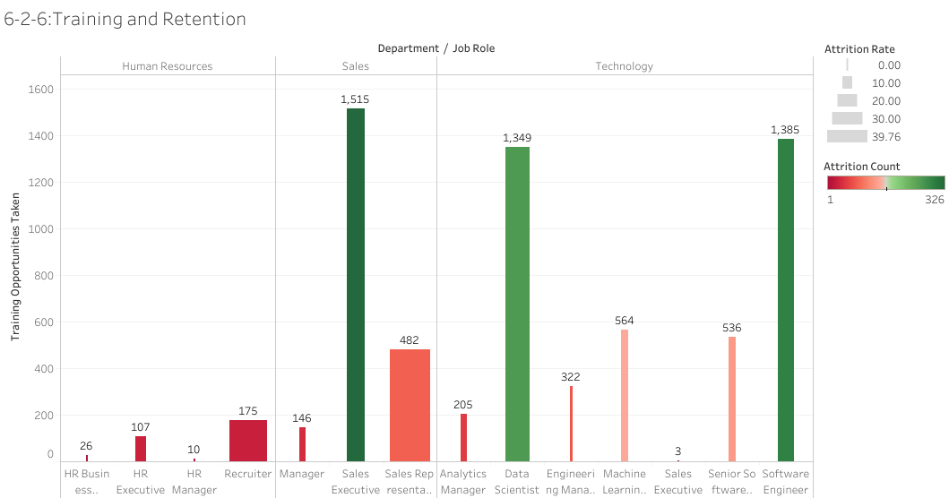
Assess whether providing training opportunities improves employee loyalty.

Slide 48
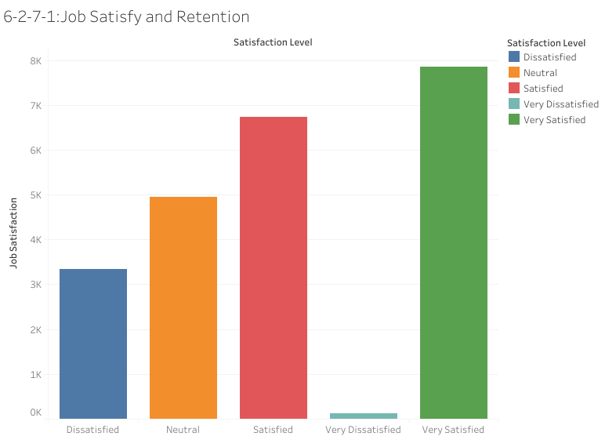
Employees with higher job satisfaction stay longer in the company

Slide 49
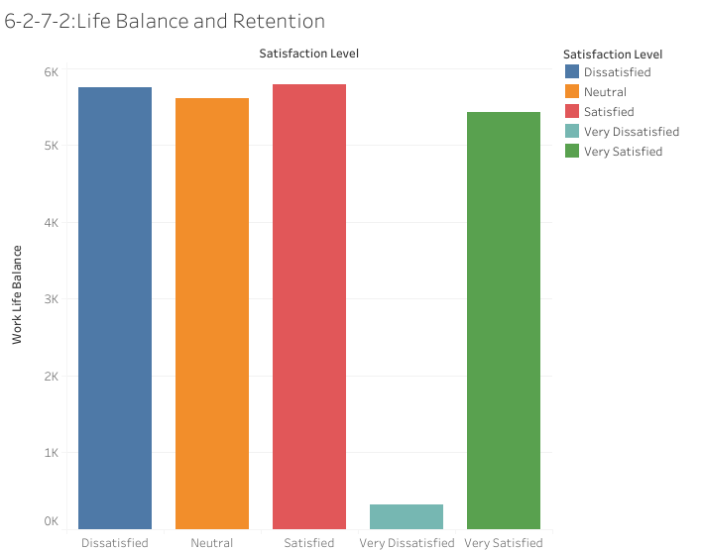
Employees with better work-life balance stay longer in the company

